Slide 1
Vocabulary
The Basics

Slide 2
Favorite Latin Word Roots:
tract
subtract
extract
attract
distract
port
to carry
support
report
export
import
rupt
to break
disrupt
erupt
rupture
interrupt
to draw
or drag
pel
impel
repel
propel
compel
mit
to send
remit
submit
remit
emit
duce
to lead
produce
introduce
reduce
induce
to drive
gress
to step
attain
maintain
contain
retain
struct
to build
construct
structure
instruct
obstruct
progress
congress
regress
aggressive
tain
to hold
s

Slide 3
Morphology Kit
Noun-Making Suffixes | Verb-Making Suffixes | Adjective-making suffixes
-ment -ness -ation, sion -ity -ism -hood -itude -ence -ance -ide | -ate -ify -ize | -acious,icious -y -ous, ious -ant -able, ible -er; est
Adverb-making suffix:
-ly

Slide 4
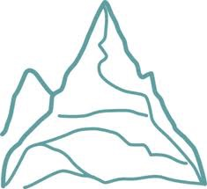
Tier 3: glossary word:
Multisyllabic
Specific to a subject area
Latin or Greek-based
topography, photosynthesis, isoceles triangle,
sedimentary, oxygenated, cartographer
Tier 2: Words of education, business,
government, religion:
Components: Prefix, root, suffix
Latin-based
elevation, formation, protrude, expansive,
isolated, remote
Tier 1: Basic conversational words: Friends & family
1 or 2 syllables
Learned naturally, through exposure
hills, grass, rocks, land, sky, clouds, fly, climb,
green, high…

